Slide 1
Safty Woman App

Slide 2
Students:
Amal Ahmed Hakami → 202000886
Sharifah ali albakkari → 202102444
Ashjan Faisal altherwi → 202103854
Rawan othman → 202185952

Slide 3
Introduction
The Women's Safety Android Application is designed to help women protect themselves in case of danger. The application alerts one of the user's designated relatives with a message and her current location via a map. The purpose of this report is to provide a detailed overview of the features and functionality of the Women's Safety Android Application.

Slide 4
Registration Process
The user starts by registering an account by providing their personal information including name, age, gender, and phone number along with the country key. The information is collected to create an account for the user on the application. This information is necessary to ensure that the user can be easily identified in case of an emergency.
The application then sends a one-time password (OTP) verification code to the entered phone number through Firebase. The OTP is sent to verify that the phone number entered by the user is correct and belongs to the user. This helps to prevent unauthorized access to the user's account and ensures that the information entered is accurate.

Slide 5
Alert Interface
After verifying the phone number, the user can enter the name and phone number of a relative. This relative is the person who will receive the alert message in case of an emergency. The relative's information is stored in the database and can be easily accessed in case of an emergency.
The alert interface is activated by shaking the phone in a certain way. The application is designed to detect the shaking of the phone and immediately send a message requesting assistance to the relative's phone. The message sent includes the user's current location, which is determined using GPS technology. This location information can be viewed on a map within the application.
In addition to sending the alert message, the user can also simulate contact with the relative from within the application. This feature allows the user to practice using the application and get familiar with its features.

Slide 6
Database Linking
The relative verifies the request on their mobile phone and enters the phone number of the woman in question along with the country key. This links the relative and the woman in the Firebase database. This linking system ensures that the relative receives the alert message in case of an emergency and provides a direct connection between the two. This helps to ensure that the necessary assistance is provided to the user in a timely manner.

Slide 7
Conclusion
In conclusion, the Women's Safety Android Application provides a comprehensive solution for women to protect themselves in case of danger. The easy registration process, the alert interface, and the database linking system work seamlessly to provide the necessary assistance to the user in an emergency. The application is designed to be user-friendly and accessible to all, making it an effective tool for women's safety. Although the application is not yet completed and has some bugs that need to be resolved in the future, it has the potential to greatly enhance the safety of women and provide peace of mind in dangerous situations.

Slide 8
Screen Shots

Slide 9

Home

Slide 10
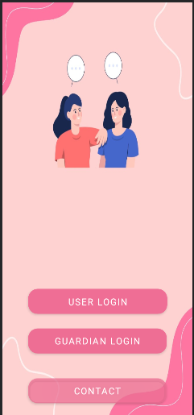
Basic Login

Slide 11
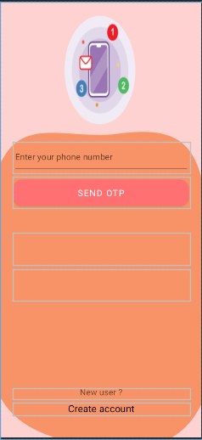
User Login

Slide 12
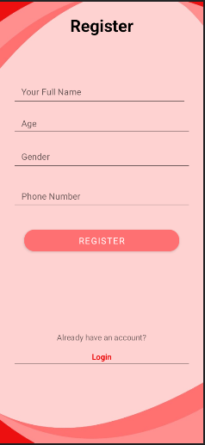
Register

Slide 13
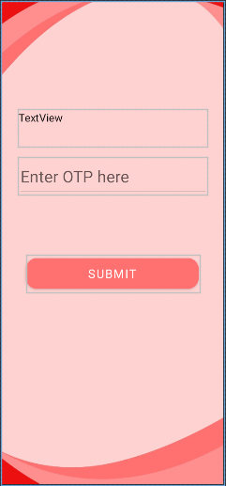
OTP

Slide 14
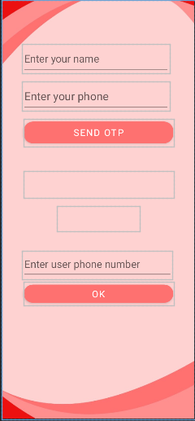
Guardian Login

Slide 15
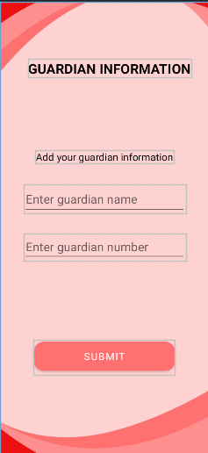
Guardian Information

Slide 16
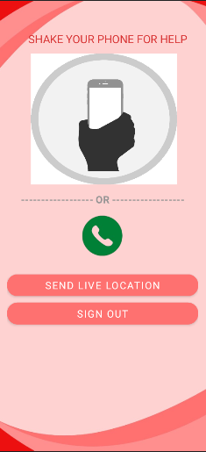
Main

Slide 17
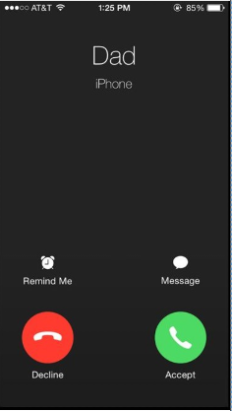
Fake Caller

Slide 18
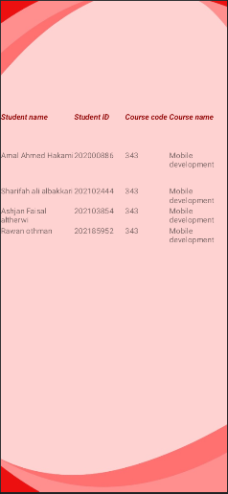
Contact

Slide 19
Thank you

